Slide 1
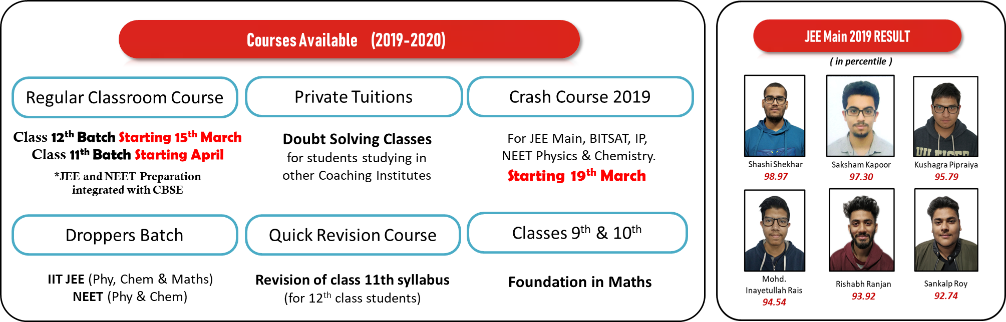

Slide 2
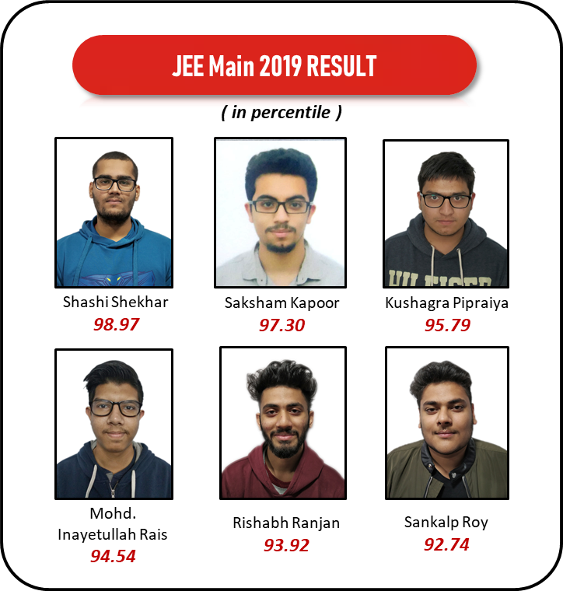
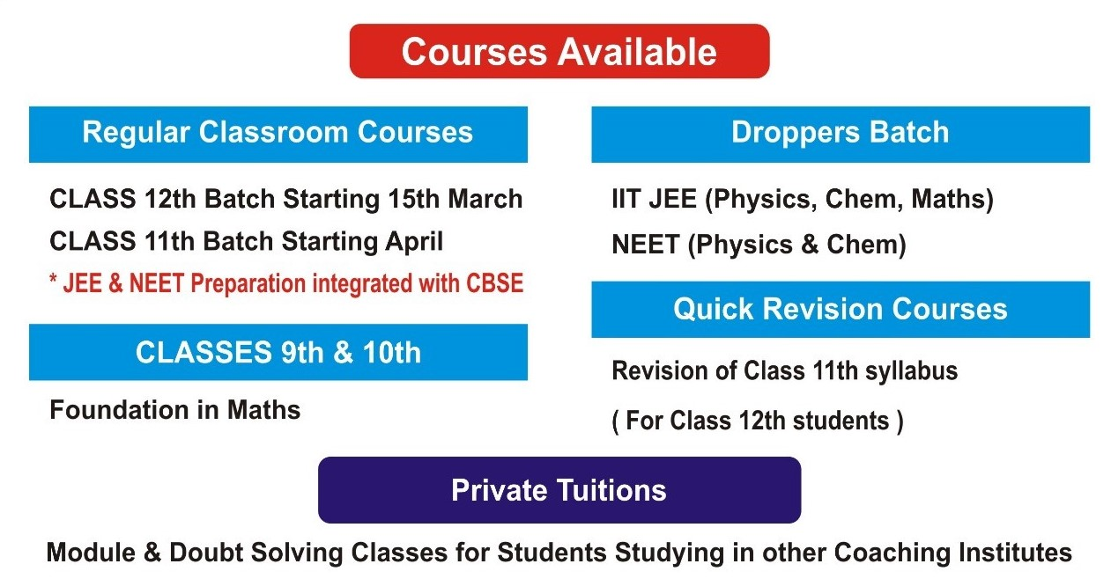
Courses Available (2019-2020)
Regular Classroom Course
Private Tuitions
Crash Course 2019
Class 12th Batch Starting 15th March
Class 11th Batch Starting April
*JEE and NEET Preparation
integrated with CBSE
Doubt Solving Classes
for students studying in
other Coaching Institutes
For JEE Main, BITSAT, IP,
NEET Physics & Chemistry.
Starting 19th March
Droppers Batch
Quick Revision Course
Classes 9th & 10th
IIT JEE (Phy, Chem & Maths)
NEET (Phy & Chem)
Revision of class 11th syllabus
(for 12th class students)
Foundation in Maths

Slide 3
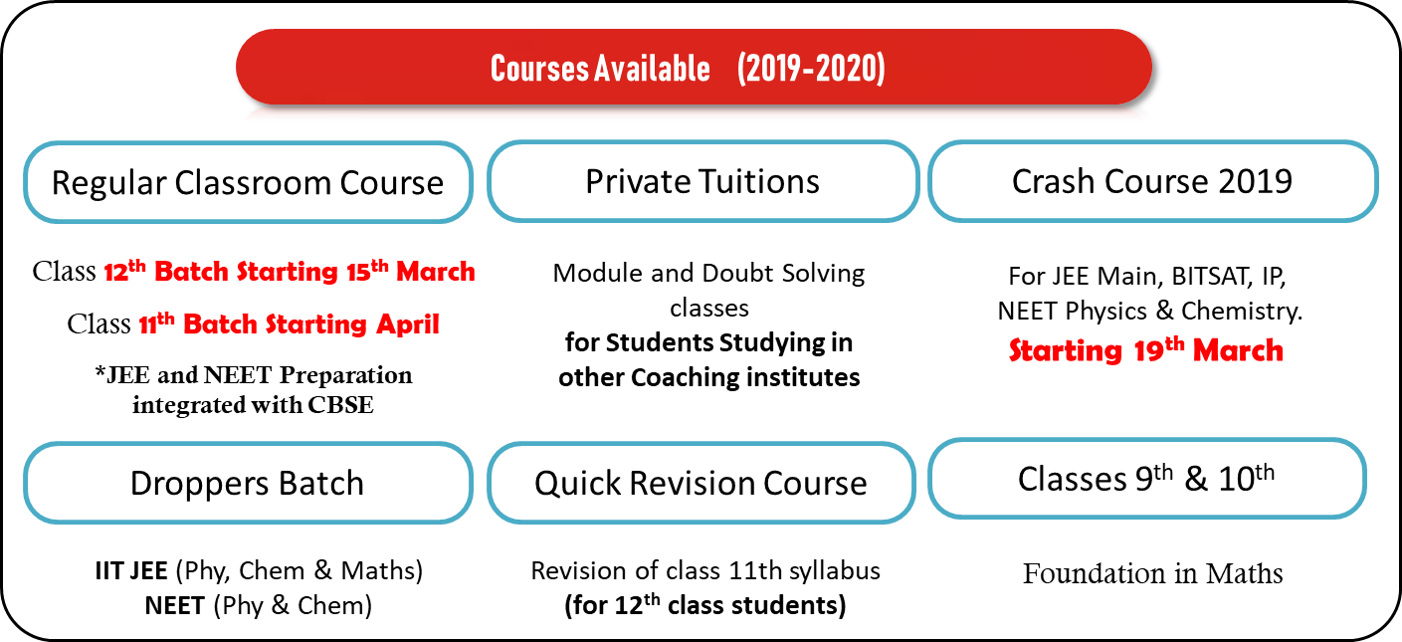
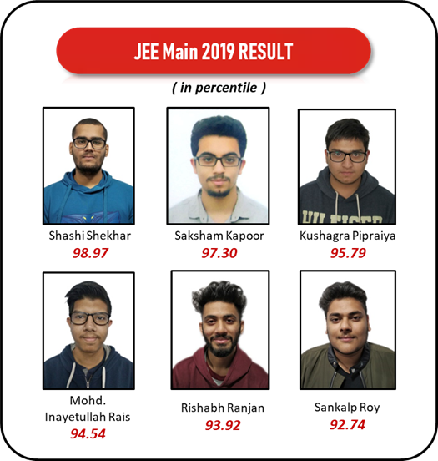

Slide 4
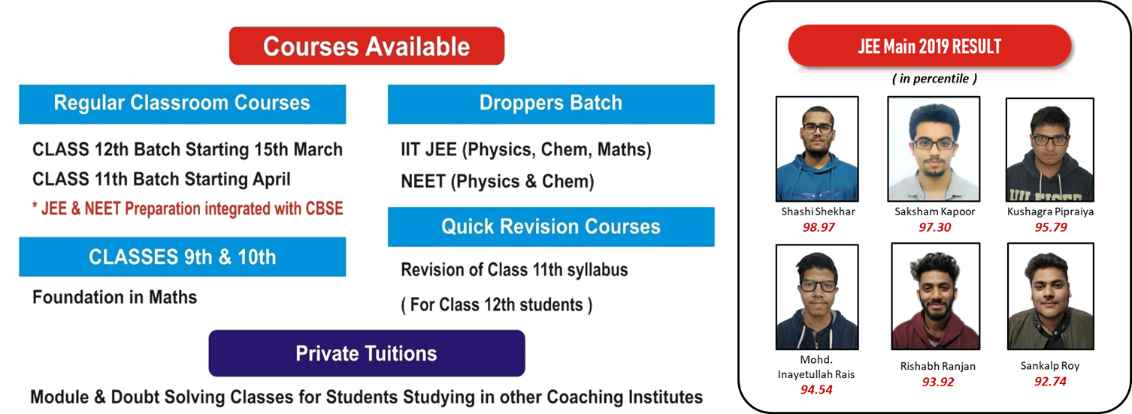

Slide 5
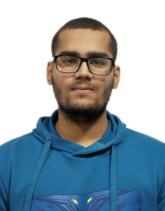
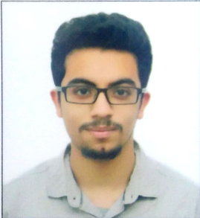
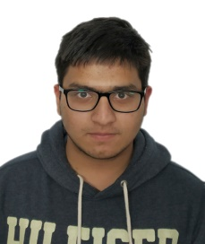
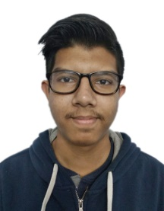
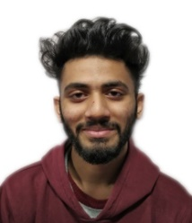

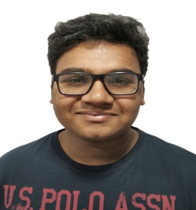
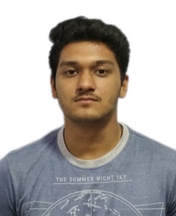
JEE Main 2019 RESULT
( in percentile )
Shashi Shekhar
98.97
Saksham Kapoor
97.30
Kushagra Pipraiya
95.79
Mohd. Inayetullah Rais
94.54
Rishabh Ranjan
93.92
Sankalp Roy
92.74
Stubh Lal
92.16
Uditansh Bhandari
90.89

Slide 6
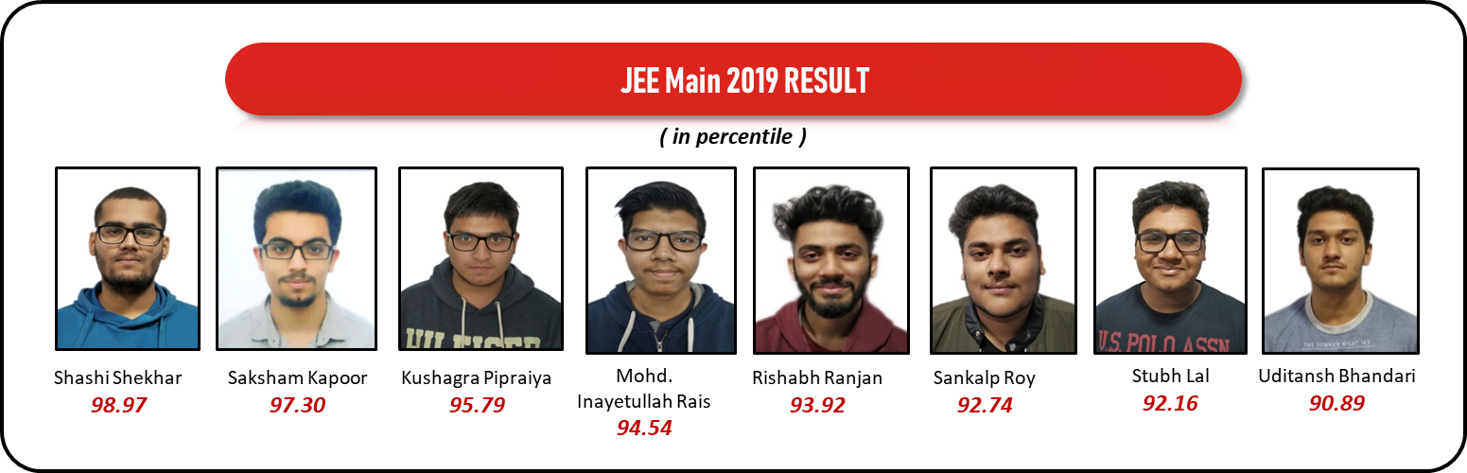

Slide 7


Slide 8
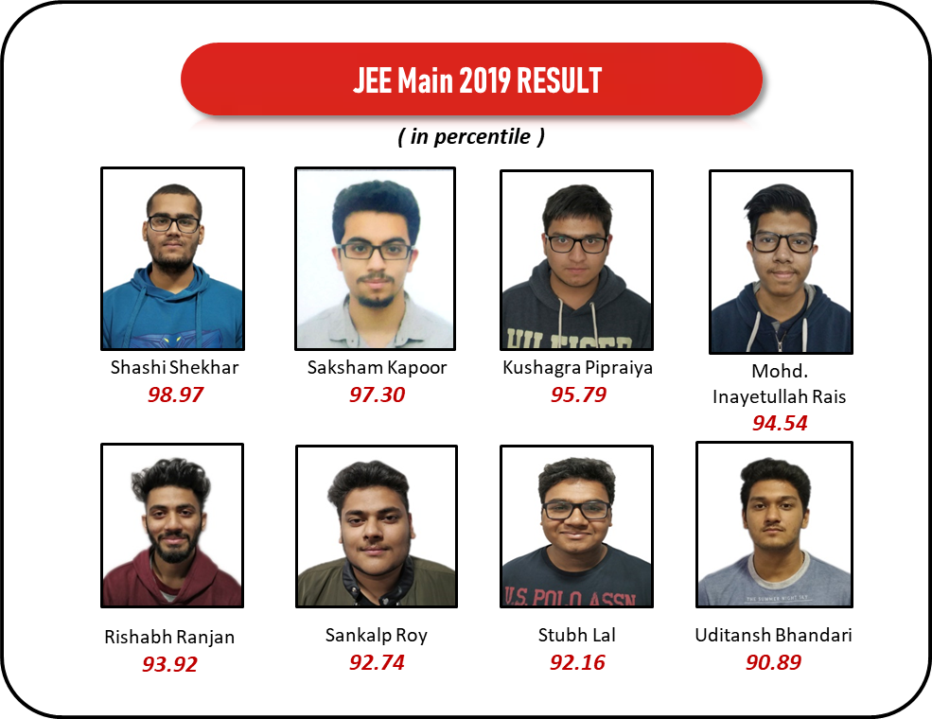

Slide 9

MATHEMATICS
REVISION VIDEOS

Slide 10
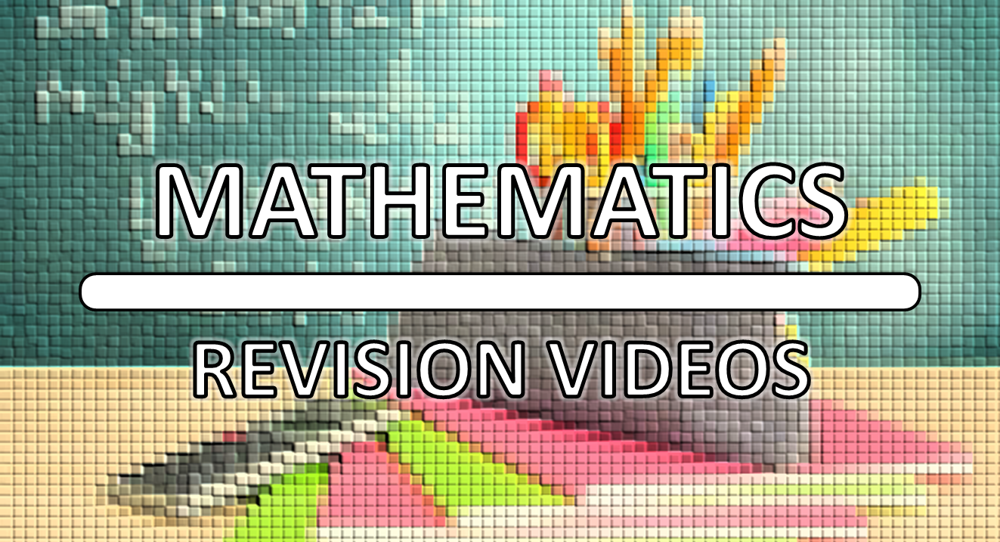

Slide 11

MATHEMATICS
REVISION VIDEOS

Slide 12
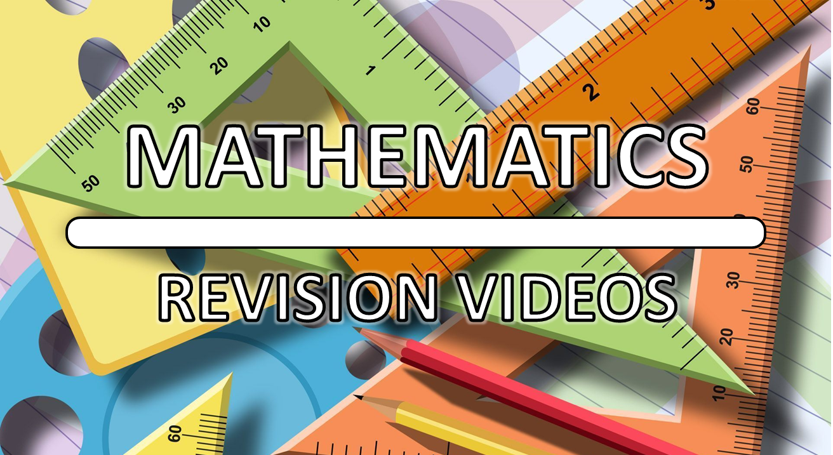

Slide 13
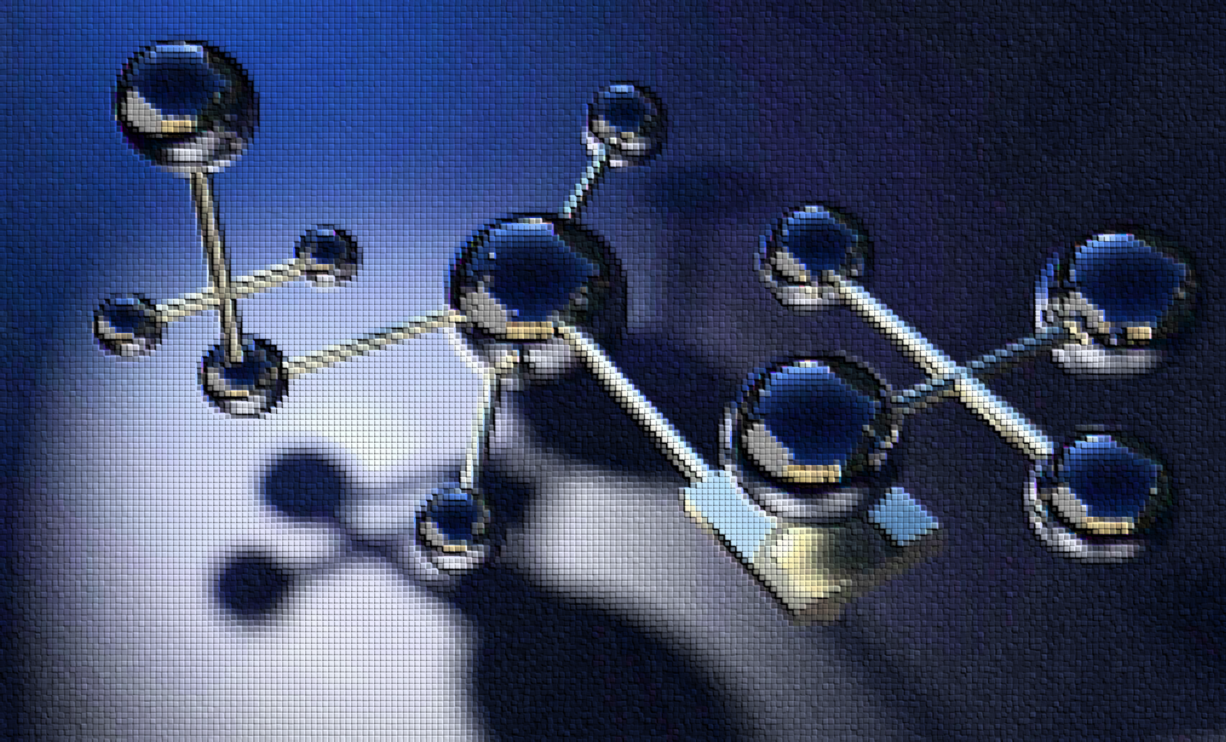
CHEMISTRY
REVISION VIDEOS

Slide 14
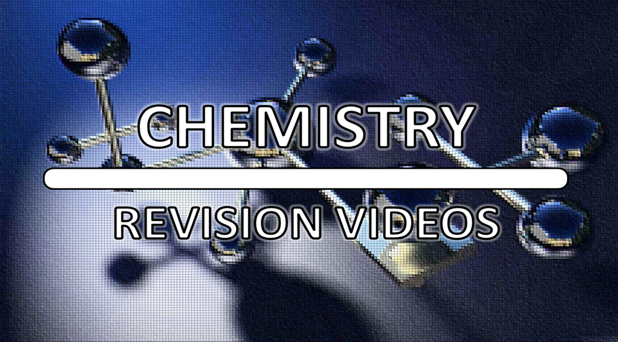

Slide 15
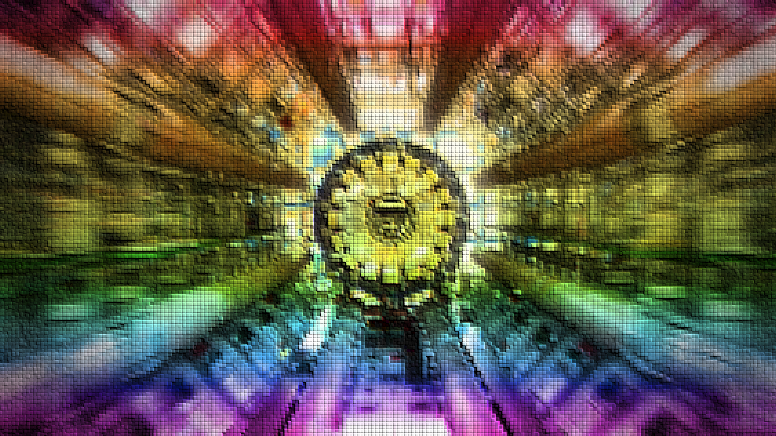
PHYSICS
REVISION VIDEOS

Slide 16
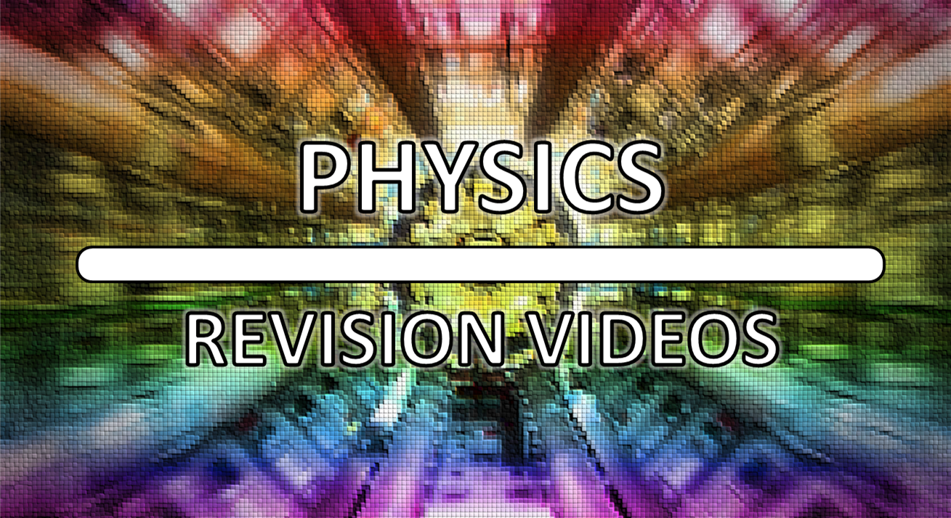

Slide 17
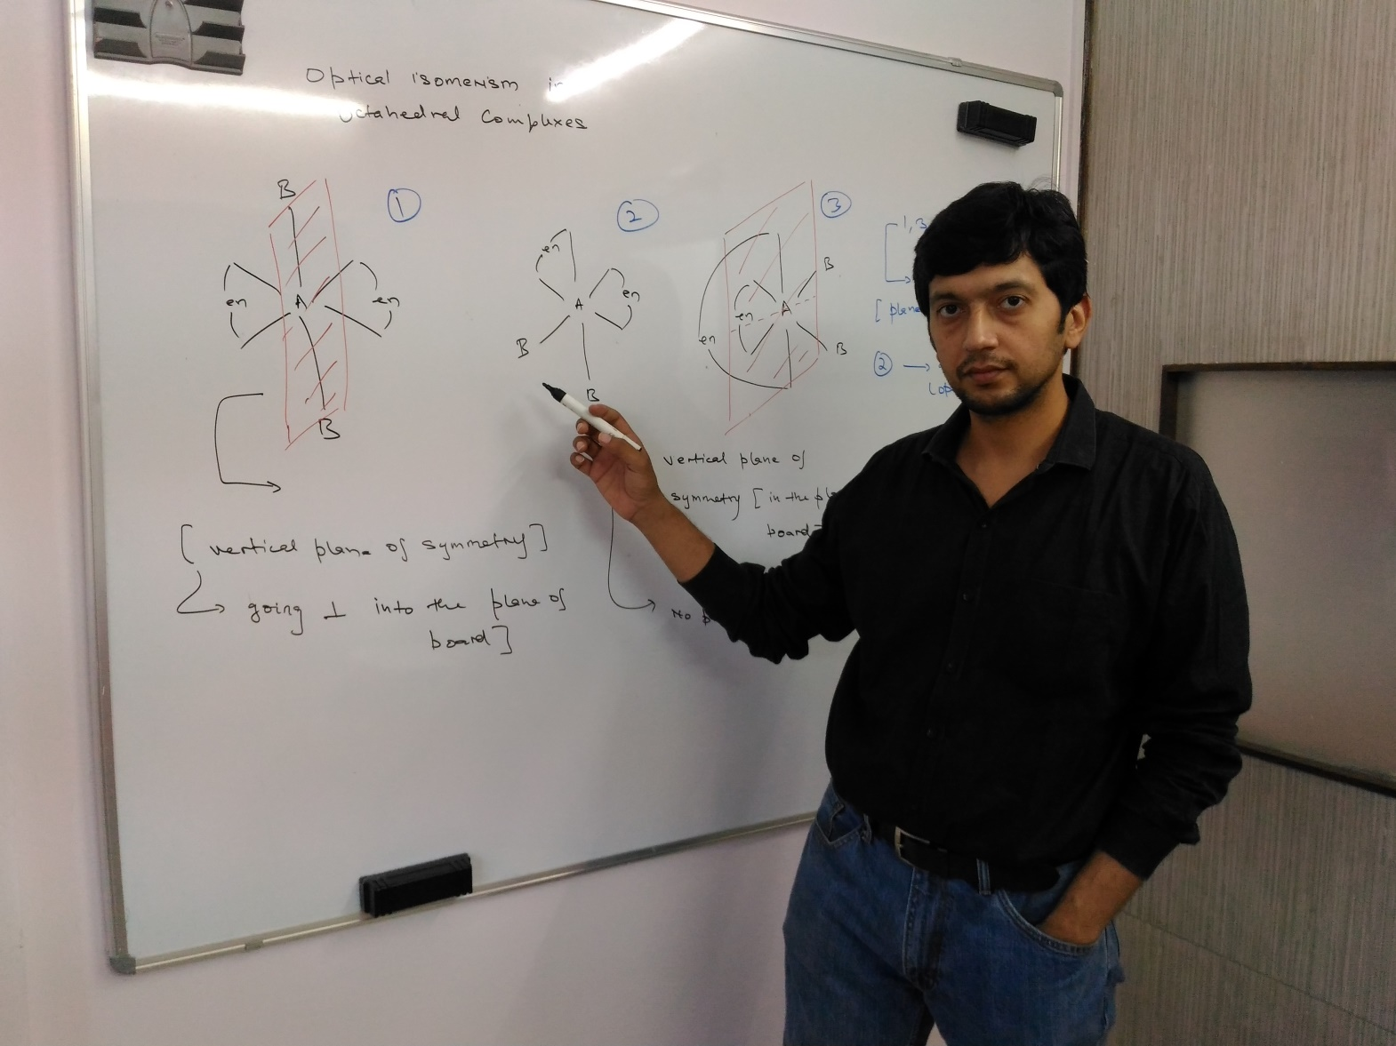

Slide 18
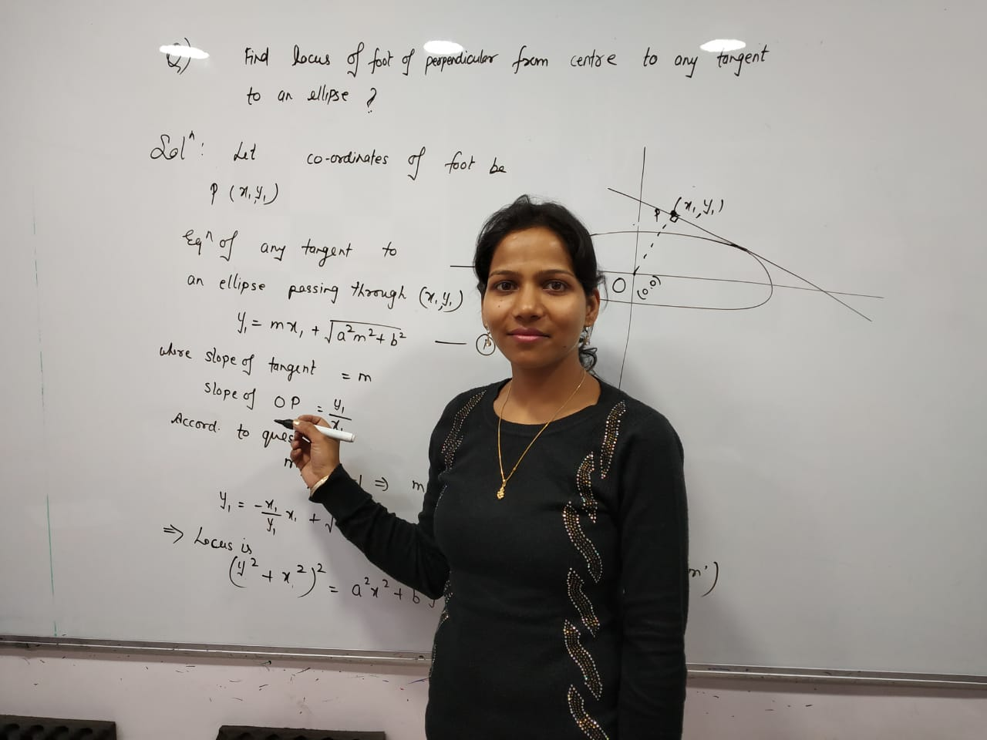
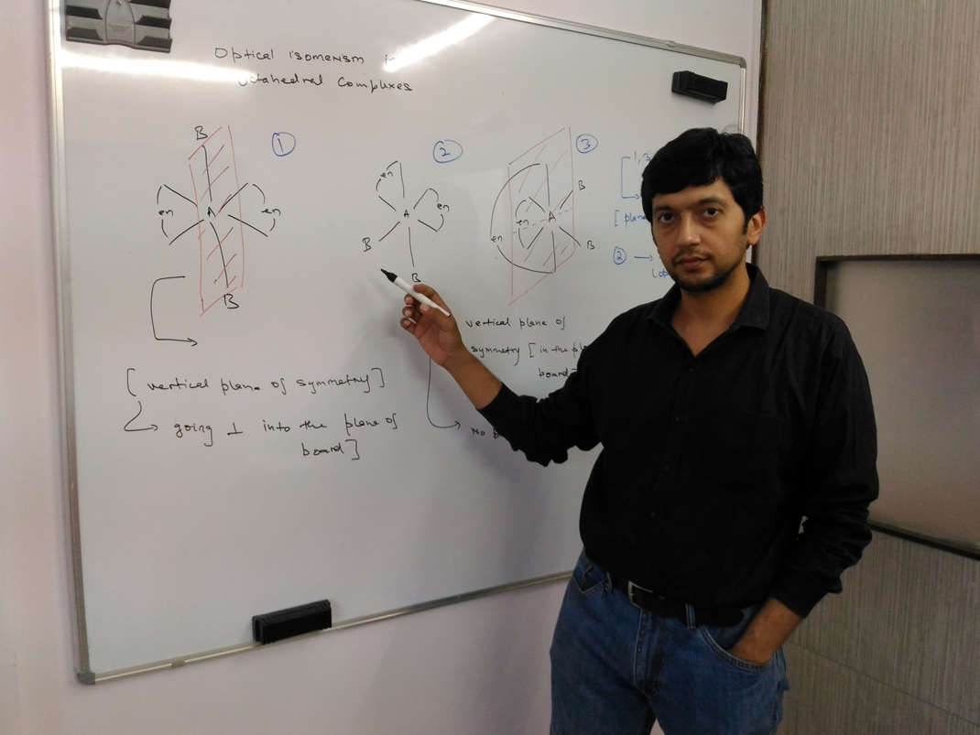

Slide 19
